Slide 1
ELTC /Computer Science
Dissertation Writing Support Course
Lesson 2

Slide 2
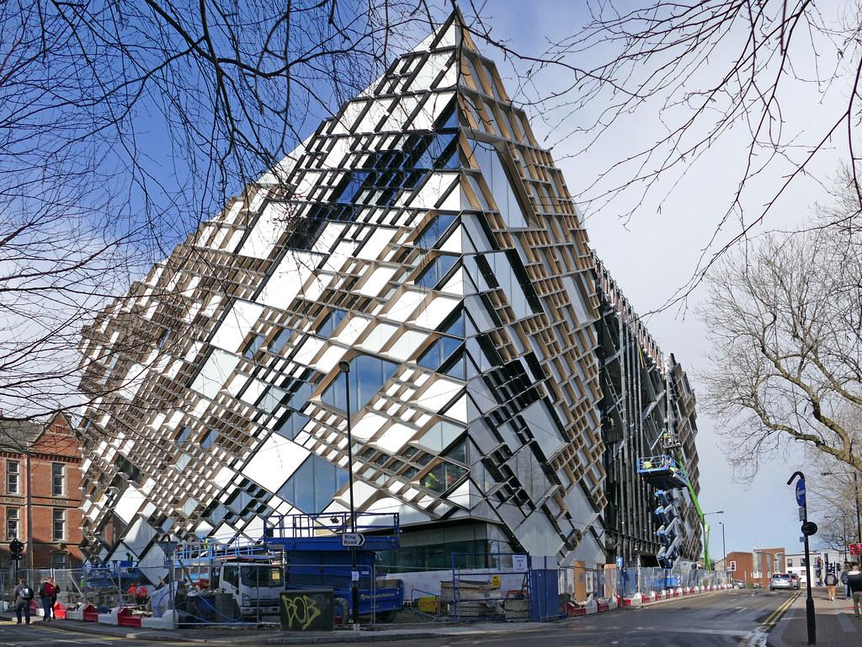
https://forms.gle/TsxwMEJMUp9YC6wo7
Please complete the form linked in the chat box

Slide 3
Lesson aims
Focus on what to include in an introduction to a dissertation.
Analyse an introduction to a dissertation.

Slide 4
Introductions
What would you expect to find in the introduction to a dissertation?
Can you think of four things you would include in the introduction?

Slide 5
The introduction should...
1.Set the scene for the project by giving a little relevant background information
2.Clearly elucidate the aims and objectives … and constraints
3.Specify the solution of a specific problem or the production of a specific system (if included in your project)
4.Outline the remaining chapters of the dissertation
5.Include a brief discussion of your view of the relationship between your project and your degree programme

Slide 6
A note about paragraph structure:
•Point (introduce the main point of the paragraph)Topic sentence
•Evidence/example (support or develop by referring to sources or giving examples, etc) Argument
•Explanation (e.g. additional information/examples/details/ cause/effect/comparisons/ advantages/disadvantages/problems/
solutions, etc Argument
•Link (to next paragraph or point)

Slide 7
1.Which ‘elements’ has the writer included in her Introduction?
2.Has she used the PEEL structure in the first paragraph?
3.Underline the verb tenses. Which verb tenses has the writer used?
4.Why has she used these verb tenses?
5.What do you notice about the sub-headings?

Slide 8
https://docs.google.com/document/d/1DQQTvm2dSc68XFNQdvoePctgU9zOvfZVSEObJCGq2_E/edit

Slide 9
Abstract or introduction?
For each description below, decide if it refers to the abstract or the introduction
This introduces the field and creates a setting for the research.
This is a separate, self-contained summary; it focuses on providing a representation of the whole article, thesis or dissertation.
This provides reference to previous research.
These have a common structure; they comment on background, and state the purpose, methods, results and conclusion.
These serve as a continuous link with other sections of the writing.
This connects the present research with what has gone before; justifies present research; identifies the aims of the present research; and leads into the main text.
This may stand alone: as a unit of text, it serves as a separate summary. The elements in the statement include a precise and clear description of the research and it highlights the results or outcomes.

Slide 10
Abstract or introduction?
For each description below, decide if it refers to the abstract or the introduction
This introduces the field and creates a setting for the research. (intro)
This is a separate, self-contained summary; it focuses on providing a representation of the whole article, thesis or dissertation. (abstract)
This provides reference to previous research. (intro)
These have a common structure; they comment on background, and state the purpose, methods, results and conclusion. (abstract)
These serve as a continuous link with other sections of the writing. (intro)
This connects the present research with what has gone before; justifies present research; identifies the aims of the present research; and leads into the main text. (intro)
This may stand alone: as a unit of text, it serves as a separate summary. The elements in the statement include a precise and clear description of the research and it highlights the results or outcomes. (abstract)

Slide 11
The introduction should...
1.Set the scene for the project by giving a little relevant background information
2.Clearly elucidate the aims and objectives … and constraints
3.Specify the solution of a specific problem or the production of a specific system (if included in your project)
4.Outline the remaining chapters of the dissertation
In recent years, there has been an increasing interest in …
Recent developments in X have heightened the need for …
The last two decades have seen a growing trend towards …
Recently, researchers have shown an increased interest in …
Over the past century, there has been a dramatic increase in …

Slide 12
The introduction should...
1.Set the scene for the project by giving a little relevant background information
2.Clearly elucidate the aims and objectives … and constraints
3.Specify the solution of a specific problem or the production of a specific system (if included in your project)
4.Outline the remaining chapters of the dissertation
The first section of this paper will examine…
This paper begins by … It will then go on to …
My thesis is composed of four themed chapters.
The essay has been organised in the following way.
The remaining part of the paper proceeds as follows: …

Slide 13
The introduction should...
1.Set the scene for the project by giving a little relevant background information
2.Clearly elucidate the aims and objectives … and constraints
3.Specify the solution of a specific problem or the production of a specific system (if included in your project)
4.Outline the remaining chapters of the dissertation
The specific objective of this study was to …
An objective of this study was to investigate …
This thesis will examine the way in which the …
This study set out to investigate the usefulness of …
This dissertation seeks to explain the development of …

Slide 14
https://www.phrasebank.manchester.ac.uk/

Slide 15
Resources: Previous Computer Science MSc Dissertations (TUOS)
Accessed via: http://www.dcs.shef.ac.uk/intranet/teaching/public/projects/dissertations.html (link is in your handbook)
You can check:
(1)how to write specific sections; and,
(2) what previous students have included
You may also get an idea for your topic (if you haven’t chosen one yet)

